Slide 1
Project Report Cars US Dataset
Group 7
Bhagya Collas - AC4885,
Fernando Nimesha – AC5296.,
Nirodha Sandaruwani - AD9906,
Loi Nguyen - AC4932,
Madee Deegoda Gamage - AD9947

Slide 2
Table of contents
01
02
03
04
05
06
Phase 1
Phase 2 & 3
Phase 4 & 5
Resources
Budget
Conclusion

Slide 3


01
Objectives
of phase 1
Use data analytics and machine learning to improve pricing, inventory turnover, and sales performance for a U.S. used car dealership chain.

Slide 4
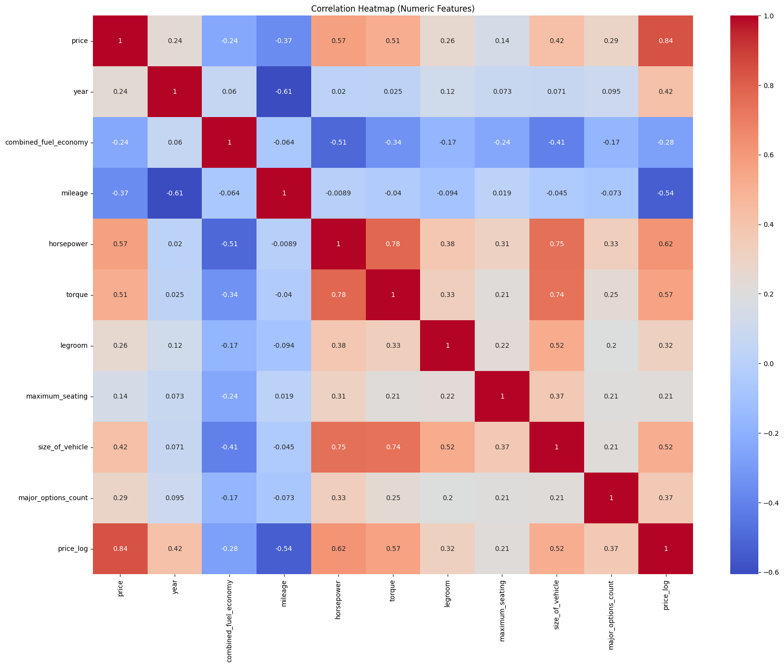
Feature Selection in phase 2 & 3
02

Slide 5
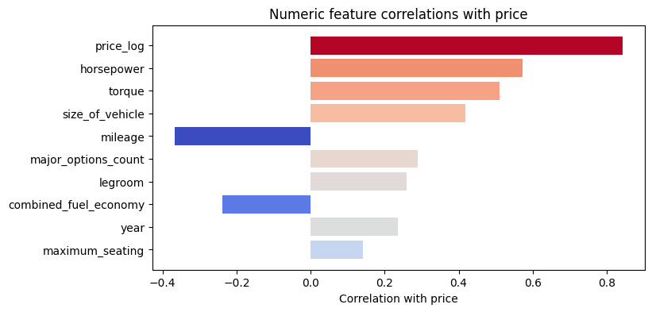

Slide 6

Feature Selection in phase 4 & 5
03

Slide 7
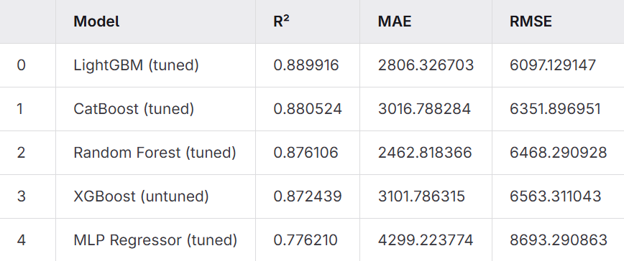
Metrics table (price)

Slide 8
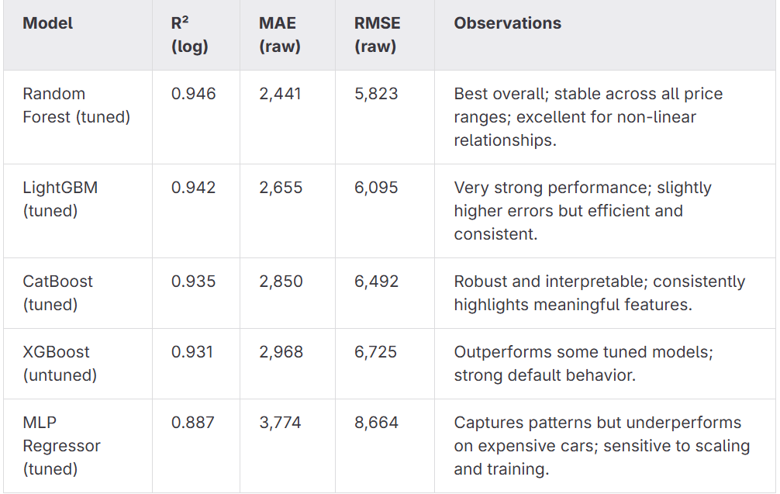
Metrics table with log(price)

Slide 9



Deployment in phase 6
04

Slide 10
Model Deployment & Monitoring
Deployment of used car price prediction model
Selected model: Random Forest Regression (log-transformed target)
Web-based deployment using cloud or institutional server
Model exposed via API (/predict) using Flask or FastAPI
Packaging of trained model with preprocessing steps
System monitoring for performance, health, and logs
Automated alerts for failures and abnormal behavior

Slide 11
Maintenance, Reporting & Users
Regular updates with new market data
Periodic model retraining for accuracy
Designed for non-technical users (students, researchers, car dealers)
1
2
3
Version control and documentation maintenance
Final project report for stakeholders
Software dependency updates
User interface improvements when needed
4
5
6
7

Slide 12
